Slide 1
Chapter 16
Security at the Application Layer:
PGP and S/MIME
16.<number>

Slide 2
Chapter 16
Objectives
To explain the general structure of an e-mail
application program
To discuss how PGP can provide security services
for e-mail
To discuss how S/MIME can provide security
services for e-mail
To define trust mechanism in both PGP and
S/MIME
To show the structure of messages exchanged in
PGP and S/MIME
16.<number>

Slide 3
16-1 E-MAIL
Let us first discuss the electronic mail (e-mail) system in general.
Topics discussed in this section:
16.1.1 E-mail Architecture
16.1.2 E-mail Security
16.<number>

Slide 4
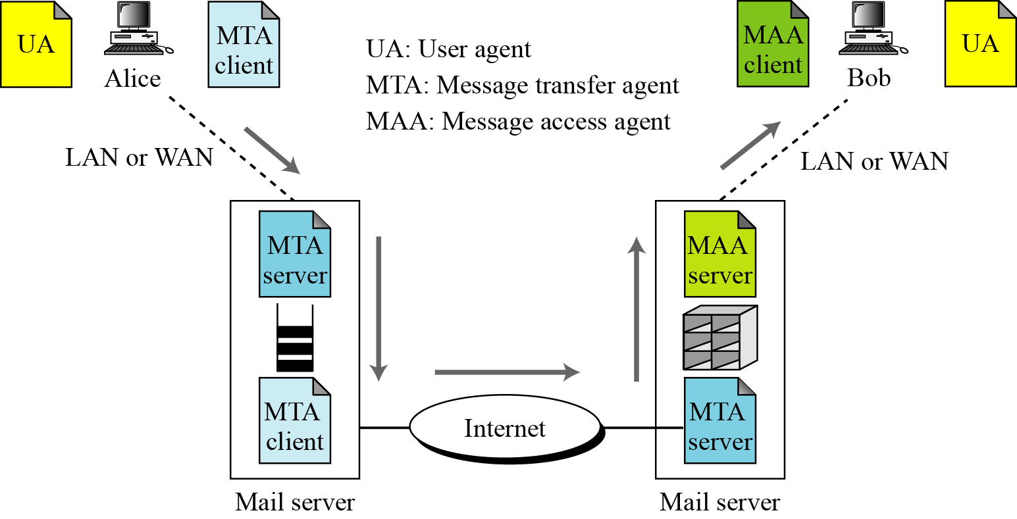
16.1.1 E-mail Architecture
Figure 16.1 E-mail architecture
is a store and retrieve activity/ push-pull program.
16.<number>

Slide 5

16.1.2 E-mail Security
A sends the message to B’s mailbox.
B reads it, sometimes later and may or may not reply.
So A and B does not create a session.
Cryptographic Algorithms
Note
In e-mail security, the sender of the message needs to include the name or identifiers of the algorithms used in the message. (like: 3DES/MD5)
16.<number>

Slide 6
16.1.2 Continued
Cryptographic Secrets
Note
In e-mail security, the encryption/decryption is done using a symmetric-key algorithm,
but the secret key to decrypt the message is encrypted with the public key of the
receiver and is sent with the message.
16.<number>

Slide 7
Certificates
It is obvious that some public-key algorithms must be used for e-mail security.
To encrypt the secret key, A needs B’s public key.
To verify a signed message, B needs A’s public key.
16.<number>

Slide 8
16-2 PGP
Pretty Good Privacy (PGP) can be used to create a secure e-mail message or to store a file securely for future retrieval.
Topics discussed in this section:
16.2.1 Scenarios
16.2.2 Key Rings
16.2.3 PGP Certificates
16.2.4 Key Revocation
16.2.5 Extracting Information from Rings
16.2.6 PGP Packets
16.2.7 PGP Messages
16.<number>

Slide 9
PGP
It was originally created by Philip Zimmermann in 1991.
Services:
PGP provides for five services:
Authentication
Confidentiality
Compression
E-mail compatibility
segmentation
16.<number>

Slide 10
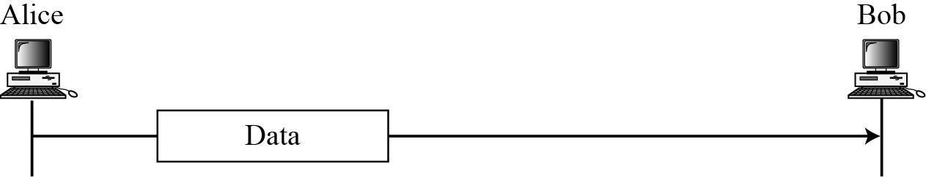
16.2.1 Scenarios
Plaintext
Figure 16.2 A plaintext message
16.<number>

Slide 11
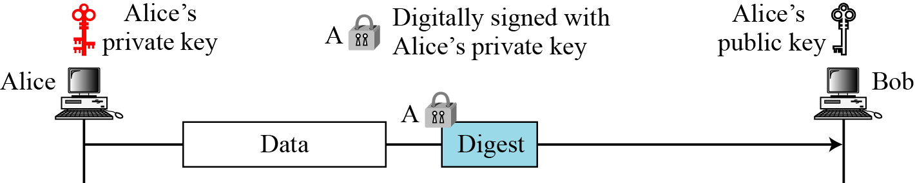
16.2.1 Continued
Message Integrity
Figure 16.3 An authenticated message
16.<number>

Slide 12
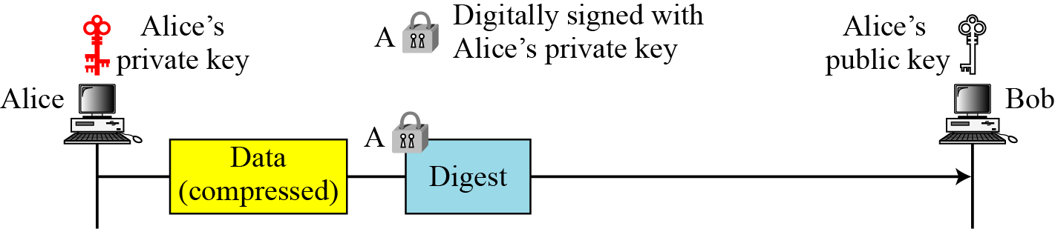
16.2.1 Continued
Compression
Figure 16.4 A compressed message
16.<number>

Slide 13
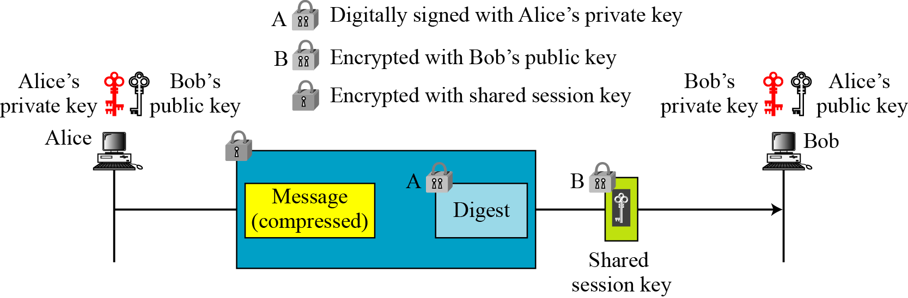
16.2.1 Continued
Confidentiality with One-Time Session Key
Figure 16.5 A confidential message
16.<number>

Slide 14
16.2.1 Continued
Code Conversion
Another service provided by PGP is code conversion. Only ASCII characters are allowed in most e-mail systems. Each character to be sent (after encryption) is converted to Radix-64 code.
Segmentation
PGP allows segmentation of the message.
16.<number>

Slide 15
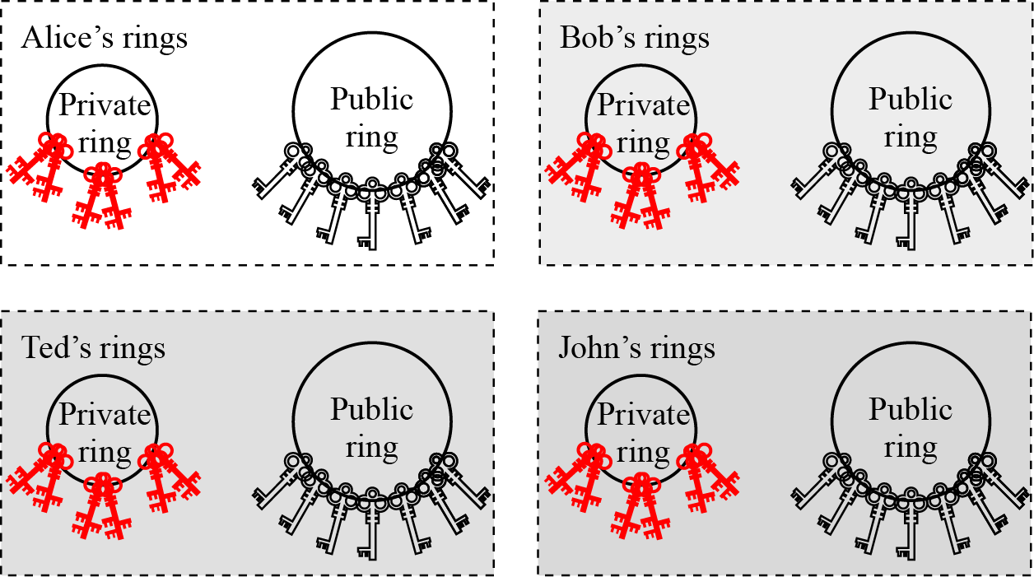
16.2.2 Key Rings
Figure 16.6 Key rings in PGP
A may need to send messages to many people.
16.<number>

Slide 16
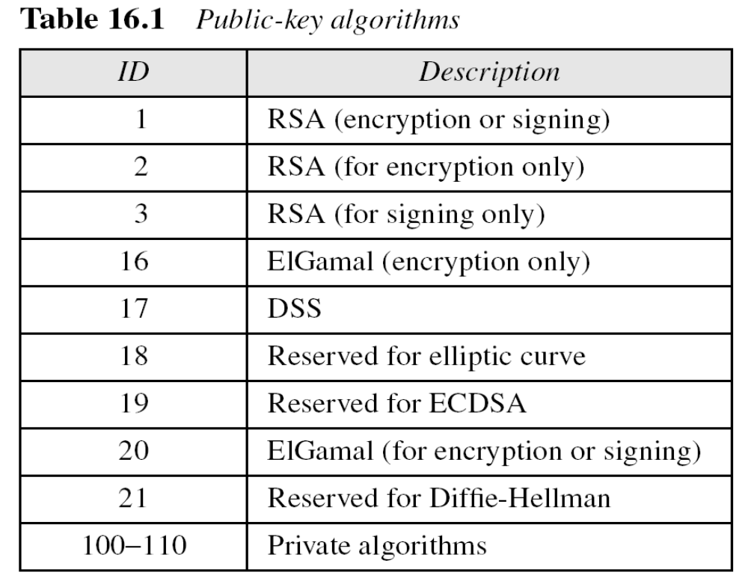
16.2.2 Continued
PGP Algorithms
16.<number>

Slide 17
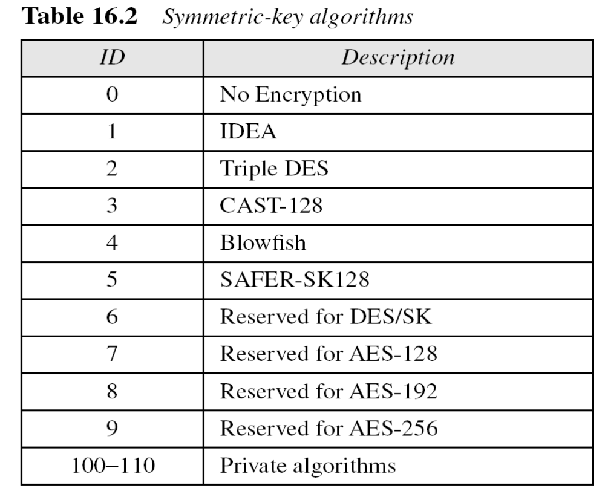
16.2.2 Continued
16.<number>

Slide 18
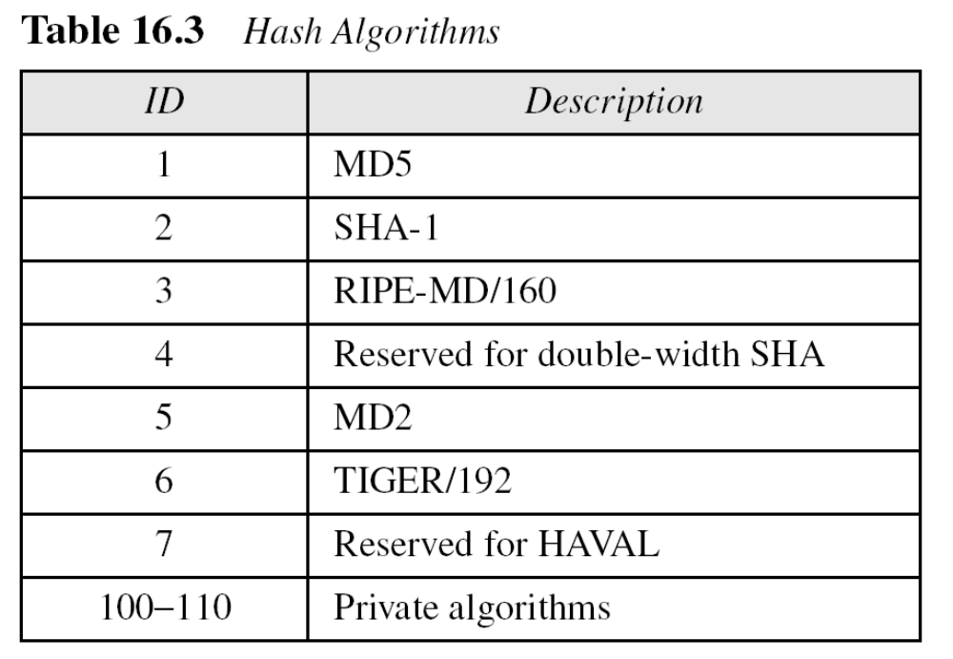
16.2.2 Continued
16.<number>

Slide 19
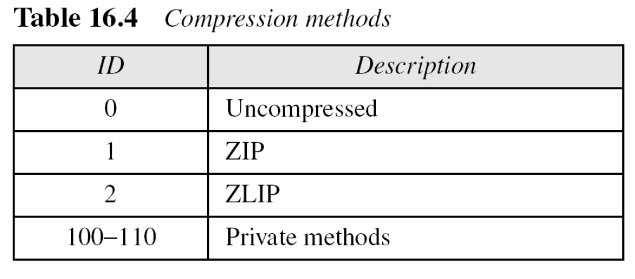
16.2.2 Continued
16.<number>

Slide 20
16.2.3 PGP Certificates
X.509 Certificates
Protocols that use X.509 certificates depend on the hierarchical structure of the trust.
Note
In X.509, there is a single path from the fully trusted authority to any certificate.
16.<number>

Slide 21
16.2.3 Continued
PGP Certificates
In PGP, there is no need for CAs; anyone in the ring can sign a certificate for anyone else in the ring. There is no tree/hierarchy of trust.
Note
In PGP, there can be multiple paths from fully or partially trusted authorities to any subject.
Trusts and Legitimacy
The entire operation of PGP is based on
introducer trust,
the certificate trust,
and the legitimacy of the public keys.
16.<number>

Slide 22
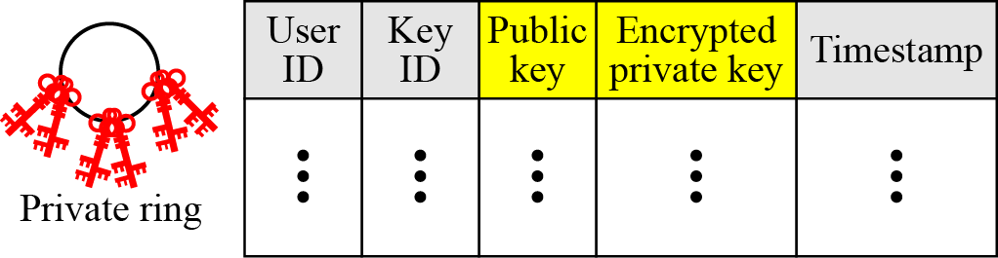
16.2.3 Continued
Figure 16.7 Format of private key ring table
16.<number>

Slide 23
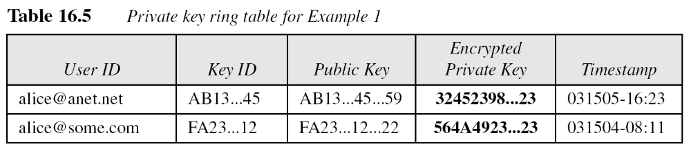
16.2.3 Continued
Example 16.1
Let us show a private key ring table for Alice. We assume that Alice has only two user IDs, alice@some.com and alice@anet.net. We also assume that Alice has two sets of private/public keys, one for each user ID.
16.<number>

Slide 24
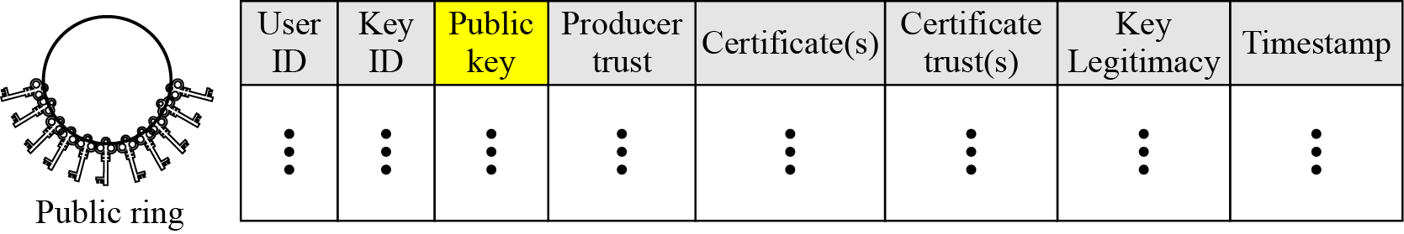
16.2.3 Continued
Figure 16.8 Format of a public key ring table
16.<number>

Slide 25
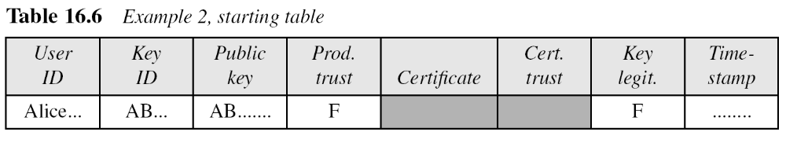
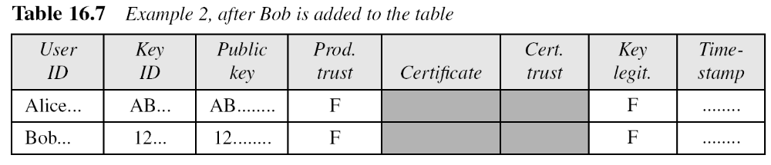
16.2.3 Continued
Example 16.2
A series of steps will show how a public key ring table is formed for Alice.
16.<number>

Slide 26
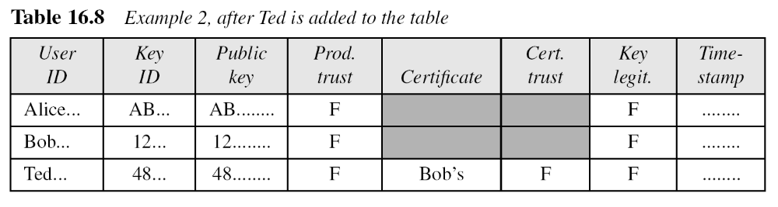
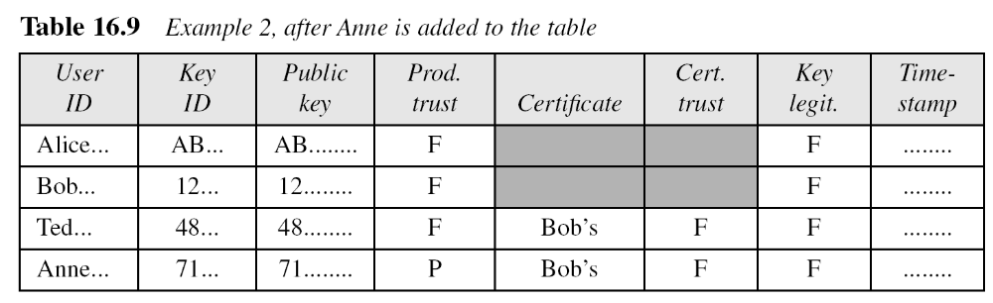
16.2.3 Continued
Example 16.2
Continued
16.<number>

Slide 27
16-3 S/MIME
Another security service designed for electronic mail is Secure/Multipurpose Internet Mail Extension (S/MIME).
The protocol is an enhancement of the Multipurpose Internet Mail Extension (MIME) protocol.
Topics discussed in this section:
16.3.1 MIME
16.3.2 S/MIME
16.3.3 Applications of S/MIME
16.<number>

Slide 28
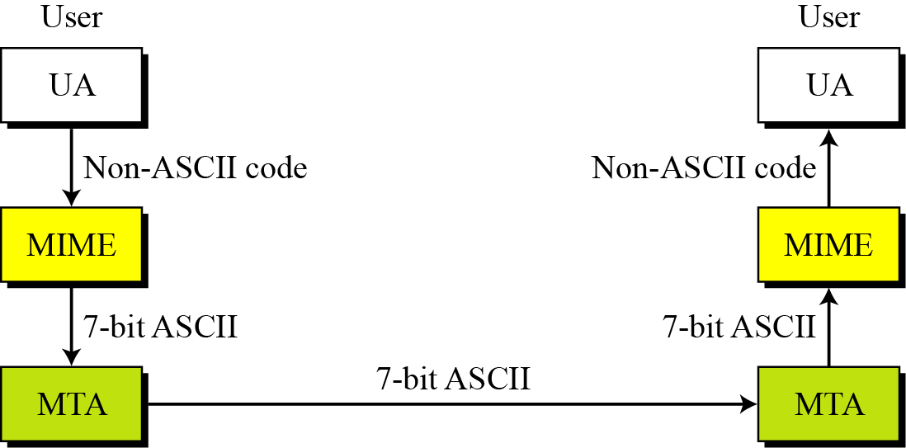
16.3.1 Continued
SMTP, supports only 7-bit ASCII characters
Figure 16.23 MIME
16.<number>

Slide 29
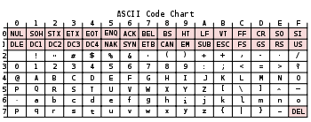
All 128 ASCII characters including non-printable characters (represented by their abbreviation).
The 95 ASCII graphic characters are numbered from 0x20 to 0x7E (32 to 126 decimal).
The space character was initially considered to be a non-printing character
16.<number>

Slide 30
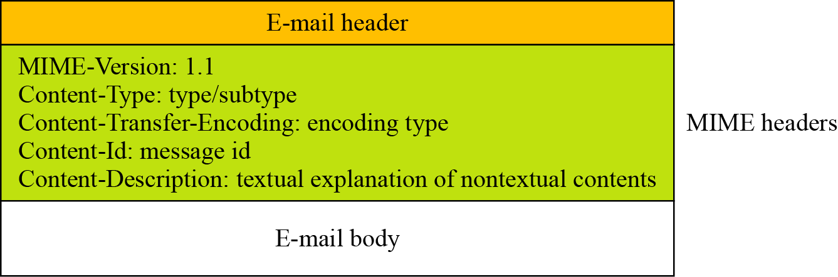
16.3.1 Continued
Figure 16.24 Teledesic
16.<number>

Slide 31
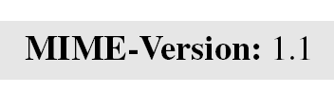

16.3.1 Continued
MIME-Version
This header defines the version of MIME used. The current version is 1.1.
Content-Type
The content type and the content subtype are separated by a slash. Depending on the subtype, the header may contain other parameters.
16.<number>

Slide 32
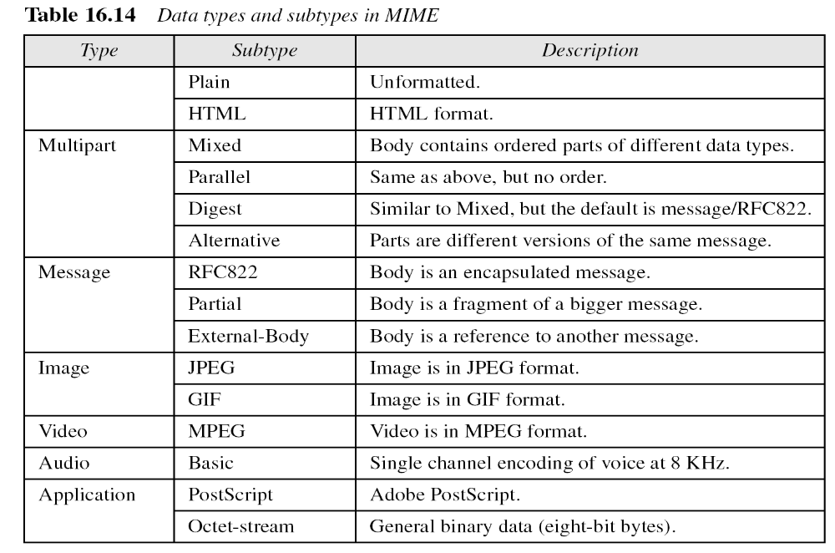
16.3.1 Continued
Text
16.<number>

Slide 33
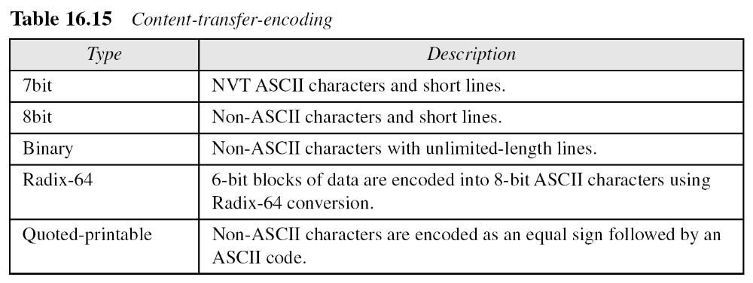
16.3.1 Continued
16.<number>

Slide 34
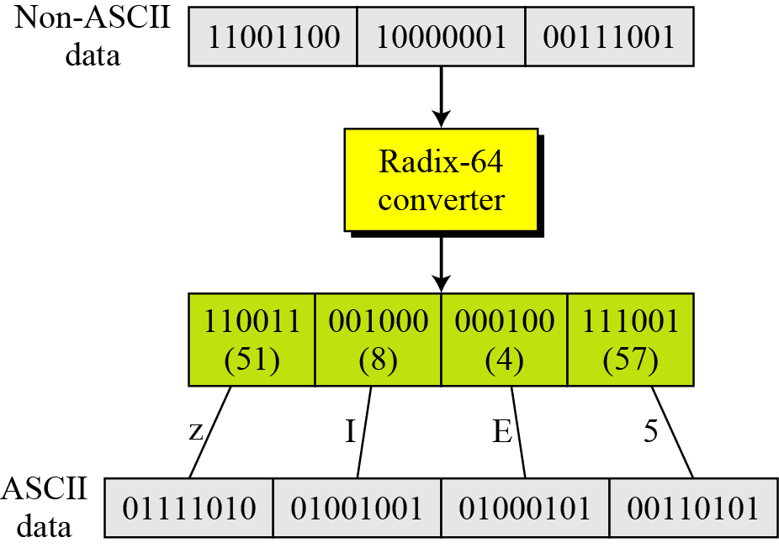
16.3.1 Continued
Figure 16.25 Radix-64 conversion
16.<number>

Slide 35
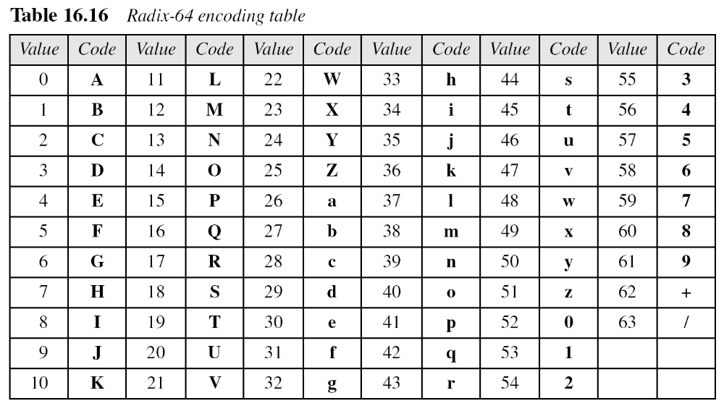
16.3.1 Continued
16.<number>

Slide 36
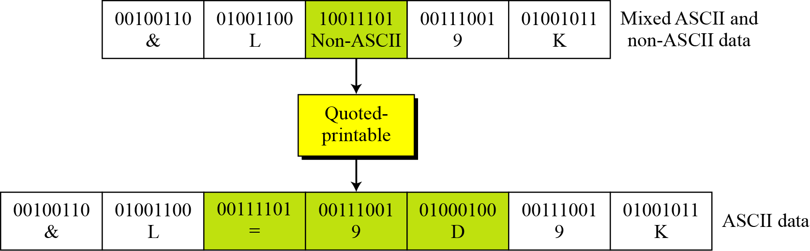
16.3.1 Continued
Figure 16.26 Quoted-printable
16.<number>

Slide 37
16.3.2 S/MIME
S/MIME adds some new content types to include security services to the MIME. All of these new types include the parameter “application/pkcs7-mime,”
“pkcs” -“Public Key Cryptography Specification.”
Cryptographic Message Syntax (CMS)
To define how security services, such as confidentiality or integrity, can be added to MIME content types, S/MIME has defined Cryptographic Message Syntax (CMS).
The syntax in each case defines the exact encoding scheme for each content type.
For details, refer to RFC 3369 and 3370.
16.<number>

Slide 38
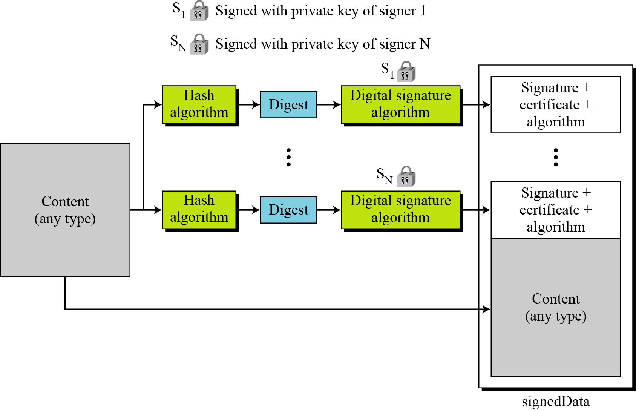
16.3.2 Continued
Figure 16.27 Signed-data content type
16.<number>

Slide 39
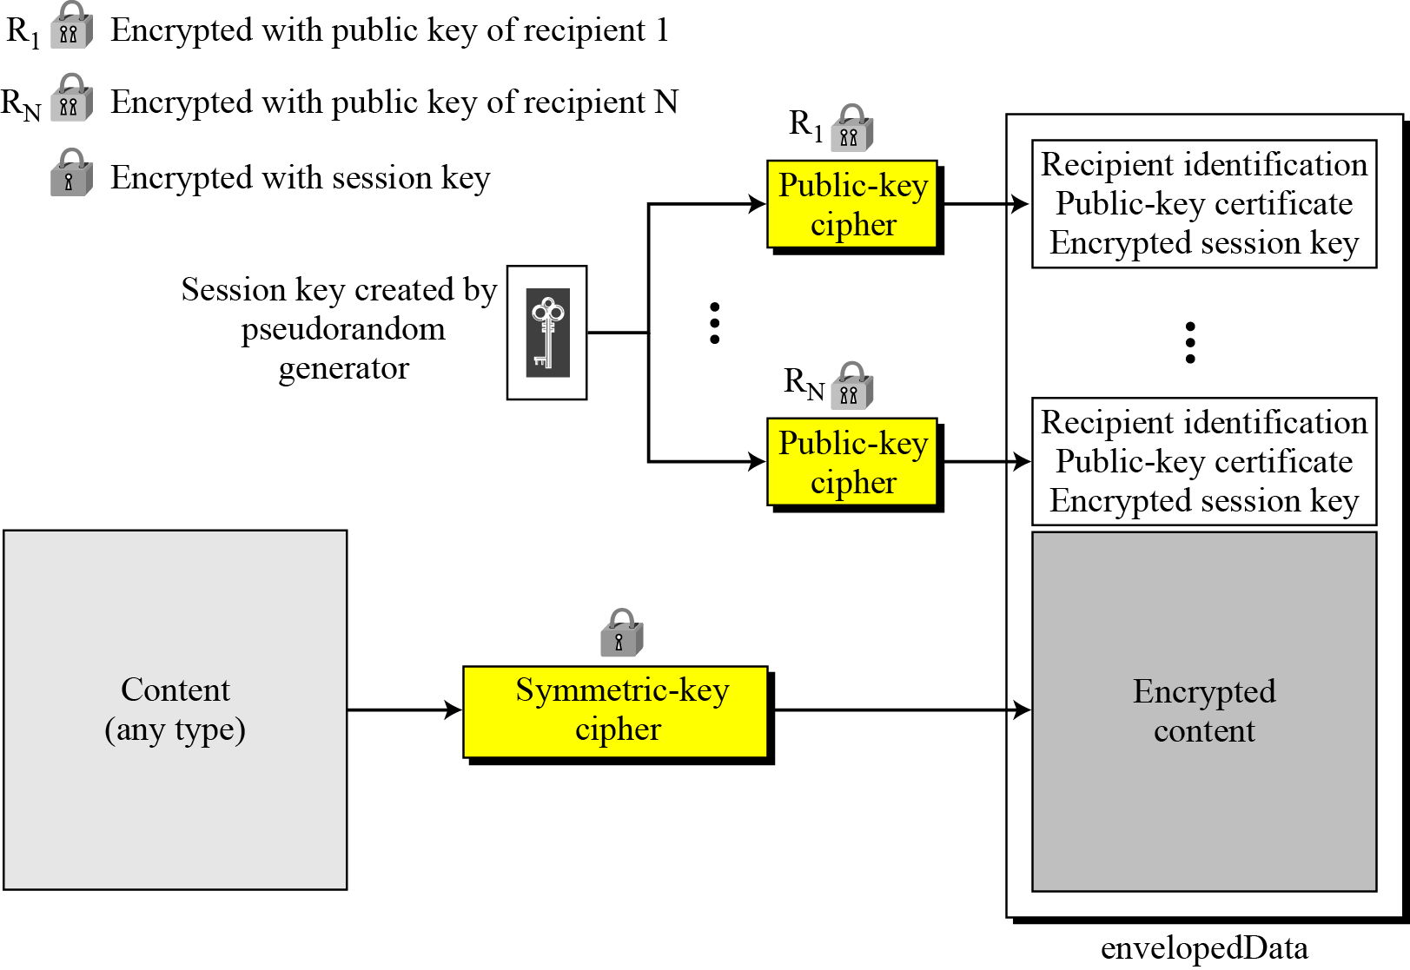
16.3.2 Continued
Figure 16.28 Enveloped-data content type
16.<number>

Slide 40
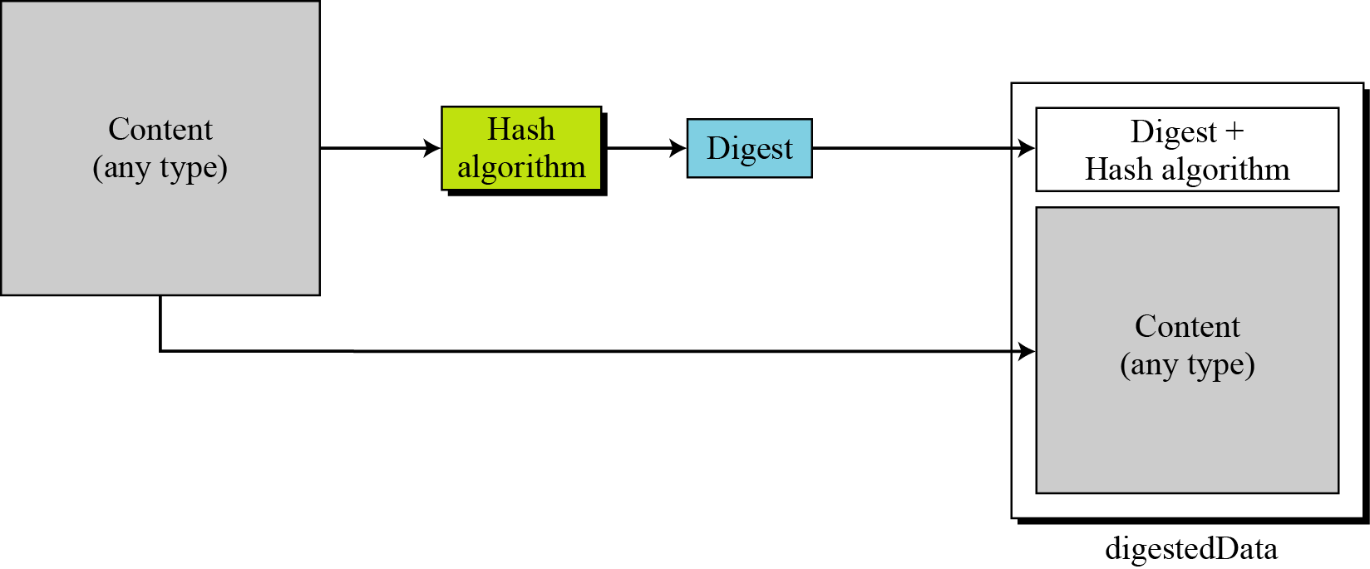
16.3.2 Continued
Figure 16.29 Digest-data content type
16.<number>

Slide 41
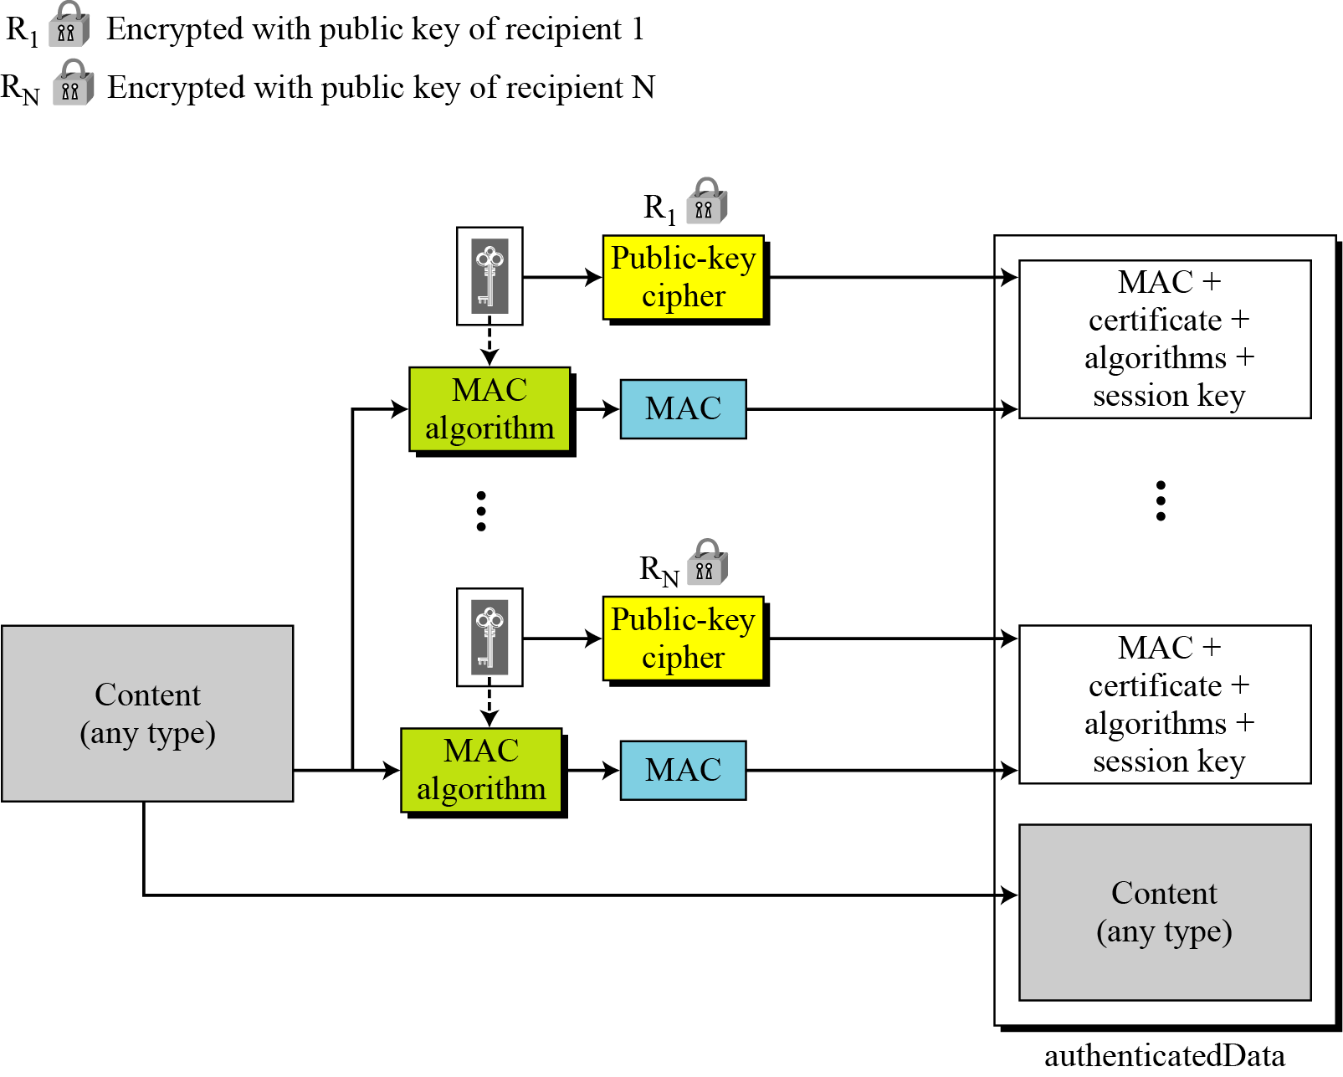
16.3.2 Continued
Figure 16.30 Authenticated-data content type
16.<number>

Slide 42
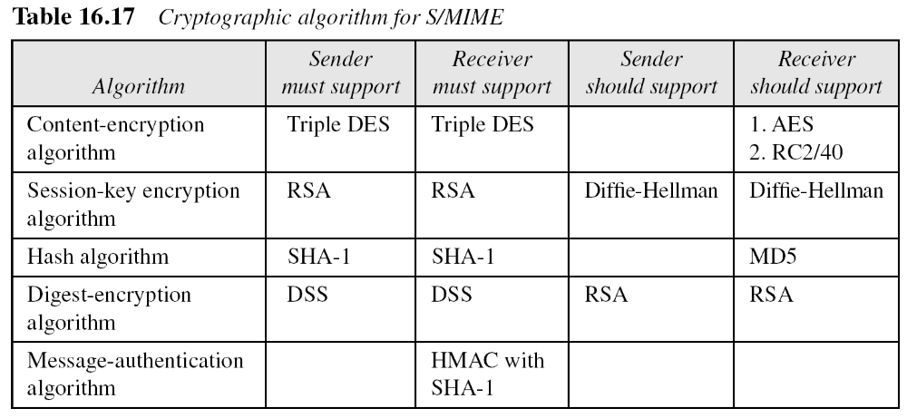
16.3.2 Continued
Cryptographic Algorithms
S/MIME defines several cryptographic algorithms. The term “must” means an absolute requirement; the term “should” means recommendation.
16.<number>

Slide 43
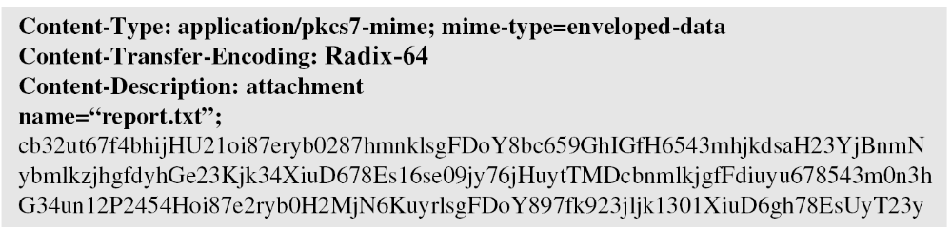
16.3.2 Continued
Example 16.3
The following shows an example of an enveloped-data in which a small message is encrypted using triple DES.
16.<number>

Slide 44
PKCS Standards Summary
PKCS Standards Summary
 | Version | Name | Comments
PKCS #1 | 2.1 | RSA Cryptography Standard^{[1]} | See RFC 3447. Defines the mathematical properties and format of RSA public and private keys (ASN.1-encoded in clear-text), and the basic algorithms and encoding/padding schemes for performing RSA encryption, decryption, and producing and verifying signatures.
PKCS #2 | - | Withdrawn | No longer active as of 2010^{[update]}. Covered RSA encryption of message digests; subsequently merged into PKCS #1.
PKCS #3 | 1.4 | Diffie–Hellman Key Agreement Standard^{[2]} | A cryptographic protocol that allows two parties that have no prior knowledge of each other to jointly establish a shared secret key over an insecure communications channel.
PKCS #4 | - | Withdrawn | No longer active as of 2010^{[update]}. Covered RSA key syntax; subsequently merged into PKCS #1.
PKCS #5 | 2.0 | Password-based Encryption Standard^{[3]} | See RFC 2898 and PBKDF2.
PKCS #6 | 1.5 | Extended-Certificate Syntax Standard^{[4]} | Defines extensions to the old v1 X.509 certificate specification. Obsoleted by v3 of the same.
PKCS #7 | 1.5 | Cryptographic Message Syntax Standard^{[5]} | See RFC 2315. Used to sign and/or encrypt messages under a PKI. Used also for certificate dissemination (for instance as a response to a PKCS#10 message). Formed the basis for S/MIME, which is as of 2010^{[update]} based on RFC 5652, an updated Cryptographic Message Syntax Standard (CMS). Often used for single sign-on.
PKCS #8 | 1.2 | Private-Key Information Syntax Standard^{[6]} | See RFC 5208. Used to carry private certificate keypairs (encrypted or unencrypted).
PKCS #9 | 2.0 | Selected Attribute Types^{[7]} | See RFC 2985. Defines selected attribute types for use in PKCS #6 extended certificates, PKCS #7 digitally signed messages, PKCS #8 private-key information, and PKCS #10 certificate-signing requests.
PKCS #10 | 1.7 | Certification Request Standard^{[8]} | See RFC 2986. Format of messages sent to a certification authority to request certification of a public key. See certificate signing request.
16.<number>

Slide 45
PKCS Standards Summary(Contd…)
PKCS #11 | 2.20 | Cryptographic Token Interface^{[9]} | Also known as "Cryptoki". An API defining a generic interface to cryptographic tokens (see also Hardware Security Module). Often used in single sign-on, Public-key cryptography and disk encryption^{[10]} systems.
PKCS #12 | 1.0 | Personal Information Exchange Syntax Standard^{[11]} | Defines a file format commonly used to store private keys with accompanying public key certificates, protected with a password-based symmetric key. PFX is a predecessor to PKCS#12.This container format can contain multiple embedded objects, such as multiple certificates. Usually protected/encrypted with a password. Usable as a format for the Java key store and to establish client authentication certificates in Mozilla Firefox. Usable by Apache Tomcat, but not by Apache HTTP Server.
PKCS #13 | – | Elliptic Curve Cryptography Standard^{[12]} | (Under development as of 2011^{[update]}.)^{[13]}
PKCS #14 | – | Pseudo-random Number Generation | (Under development as of 2011^{[update]}.)^{[13]}
PKCS #15 | 1.1 | Cryptographic Token Information Format Standard^{[14]} | Defines a standard allowing users of cryptographic tokens to identify themselves to applications, independent of the application's Cryptoki implementation (PKCS #11) or other API. RSA has relinquished IC-card-related parts of this standard to ISO/IEC 7816-15.^{[15]}
16.<number>

